Slide 1
Formal Proof Generation
Huangzhao Zhang
zhang_hz@pku.edu.cn

Slide 2
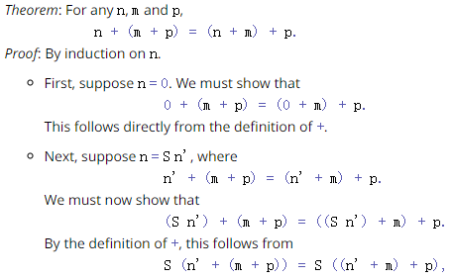
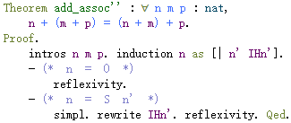
Proof
Proof – A proof is an act of communication (Software Foundations)
A proof of a mathematical proposition P is a written (or spoken) text that instills in the reader or hearer the certainty that P is true -- an unassailable argument for the truth of P.
Informal proof – “Algorithm”
Formal proof – “Code”

Slide 3
Formal Proof
Formal proof – In logic and mathematics, a formal proof or derivation is a finite sequence of sentences (called well-formed formulas in the case of a formal language), each of which is an axiom, an assumption, or follows from the preceding sentences in the sequence by a rule of inference. (WIKIPEDIA)
Functional programming
Inference rule – Induction, deduction, …
Tactic – Lemma rewriting, reflexivity, …

Slide 4
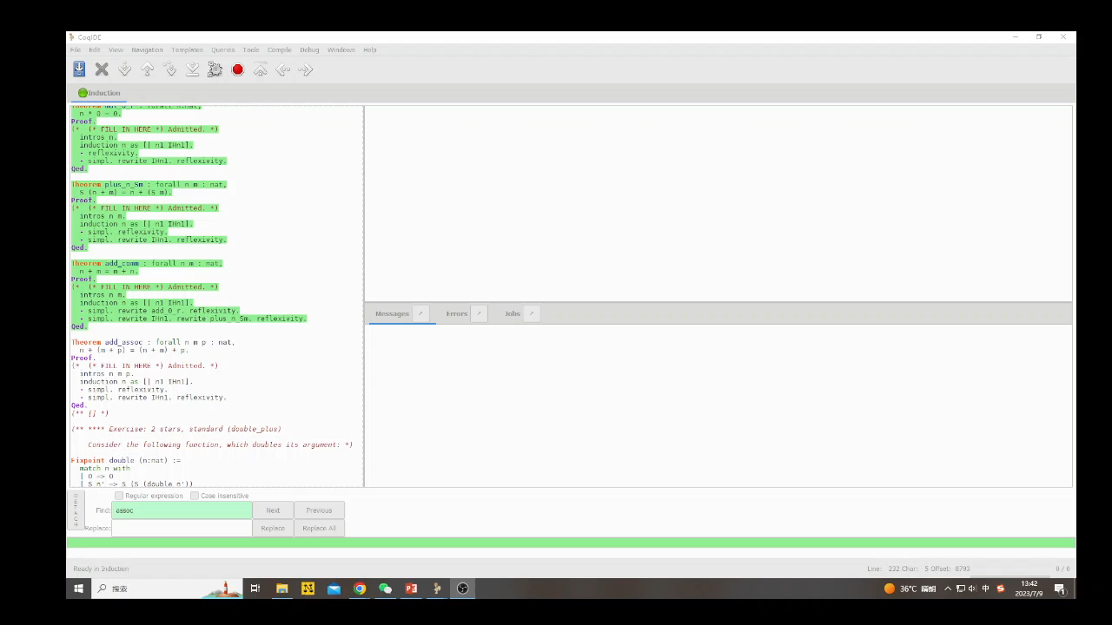
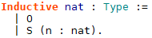
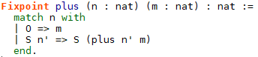
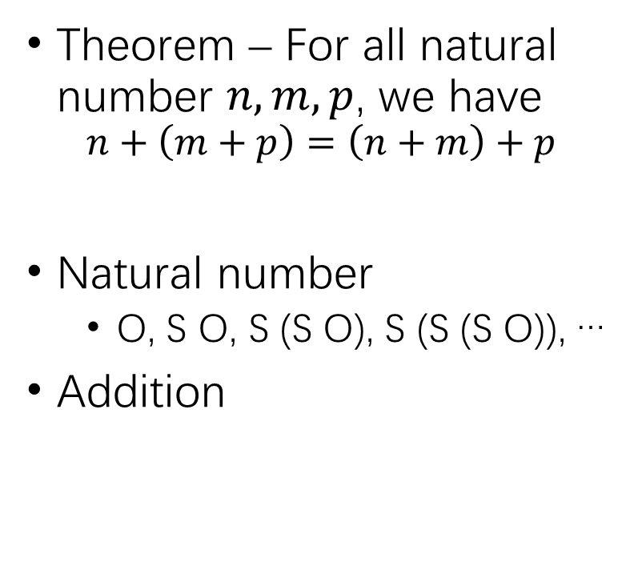
Formal Proof (2)
Theorem – For all natural number $n,m,p$, we have
$$n+\left(m+p\right)=\left(n+m\right)+p$$
Natural number
O, S O, S (S O), S (S (S O)), …
Addition

Slide 5
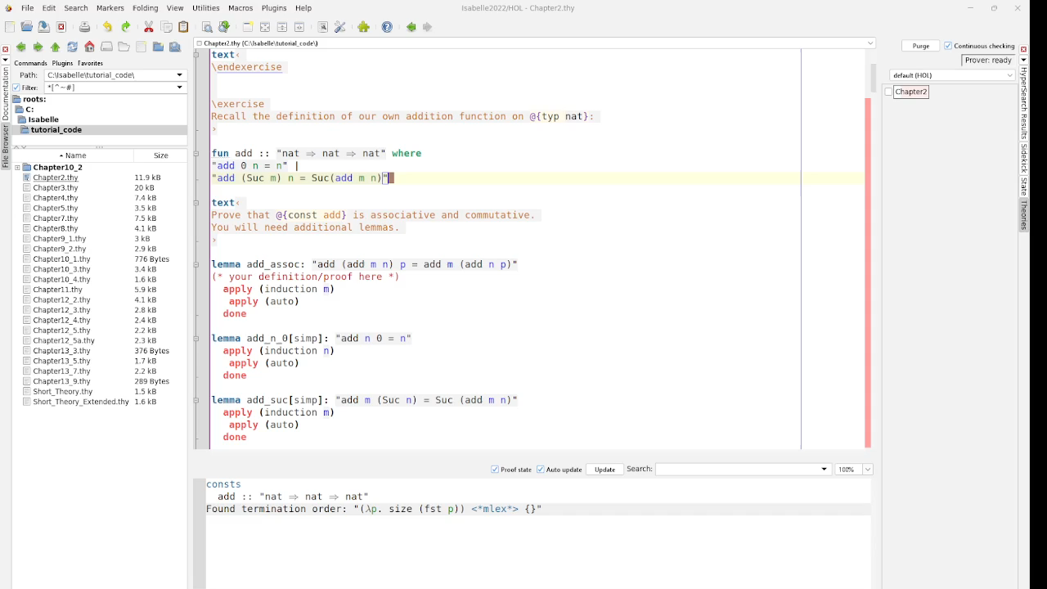
Formal Proof (3)

Slide 6
Formal Proof (4)
Interactive theorem proving – Higher order logic (HOL)
Coq – Four-color theorem, …
Isabelle – SEL4, the first operating system with feature proofs; …
Lean
…
Automated formal proof – Combinatorial optimization
I.e., program synthesis, or code generation

Slide 7
Automated Formal Proof
Hammer – Almost pure violence
Sledgehammer – Isabelle
Search – Predict next likely proof steps
LLM

Slide 8
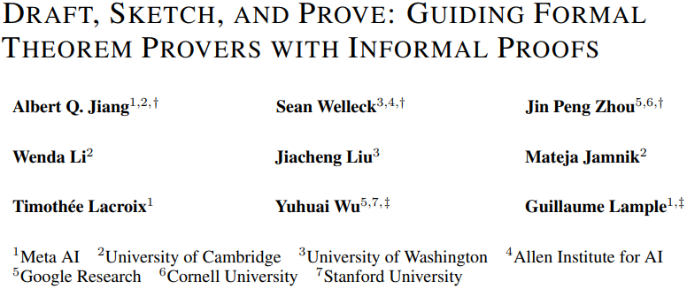

Slide 9
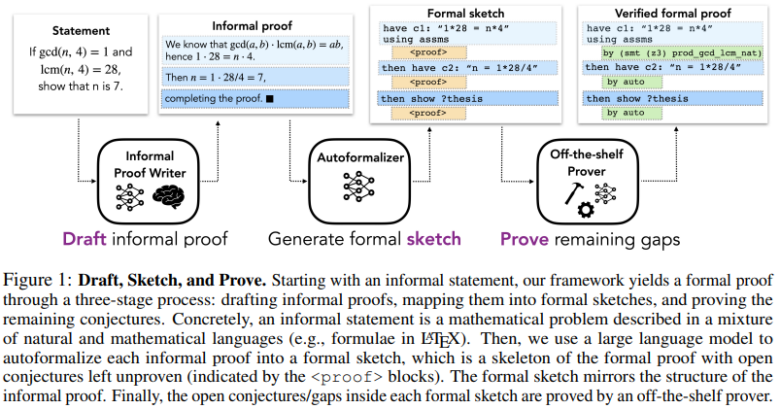
DSP (Isabelle)

Slide 10
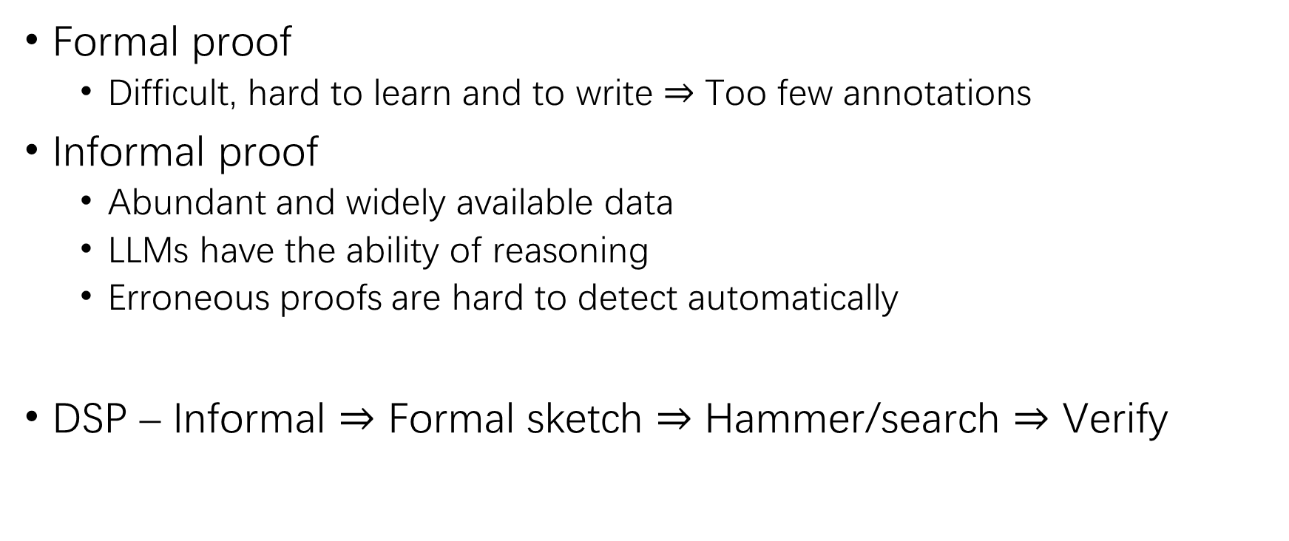
DSP Framework
Formal proof
Difficult, hard to learn and to write $⇒$ Too few annotations
Informal proof
Abundant and widely available data
LLMs have the ability of reasoning
Erroneous proofs are hard to detect automatically
DSP – Informal $⇒$ Formal sketch $⇒$ Hammer/search $⇒$ Verify

Slide 11
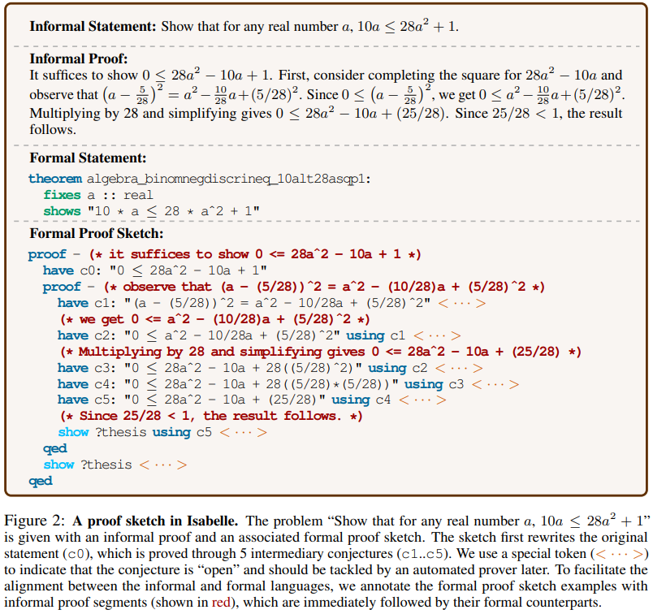
DSP Framework (2)

Slide 12
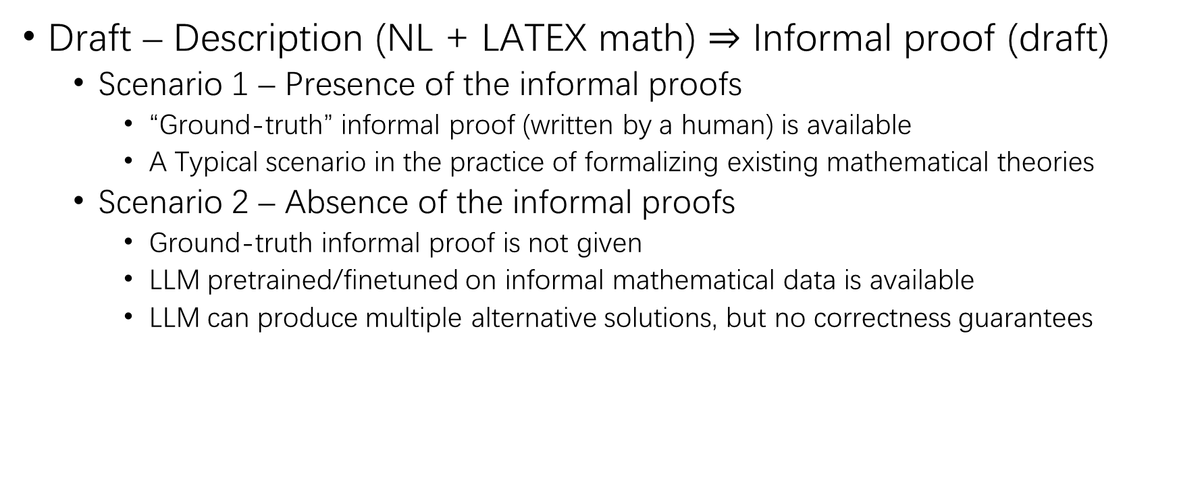
Draft Informal Proof
Draft – Description (NL + LATEX math) $⇒$ Informal proof (draft)
Scenario 1 – Presence of the informal proofs
“Ground-truth” informal proof (written by a human) is available
A Typical scenario in the practice of formalizing existing mathematical theories
Scenario 2 – Absence of the informal proofs
Ground-truth informal proof is not given
LLM pretrained/finetuned on informal mathematical data is available
LLM can produce multiple alternative solutions, but no correctness guarantees

Slide 13
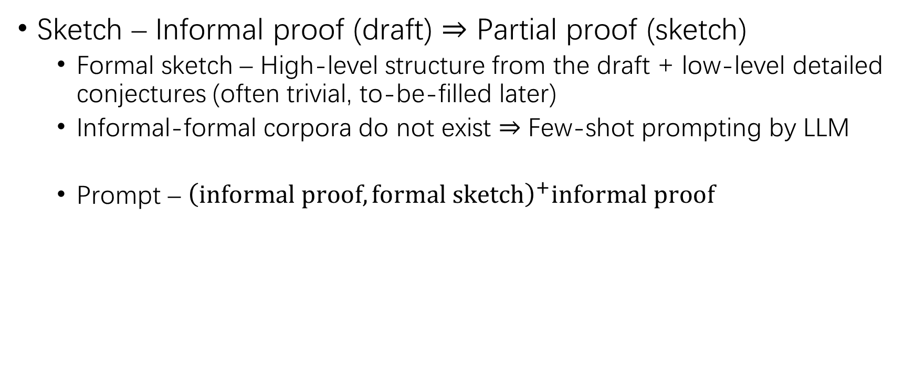
Generate Formal Sketch
Sketch – Informal proof (draft) $⇒$ Partial proof (sketch)
Formal sketch – High-level structure from the draft + low-level detailed conjectures (often trivial, to-be-filled later)
Informal-formal corpora do not exist $⇒$ Few-shot prompting by LLM
Prompt – ${\left(informal proof, formal sketch\right)}^{+}informal proof$

Slide 14
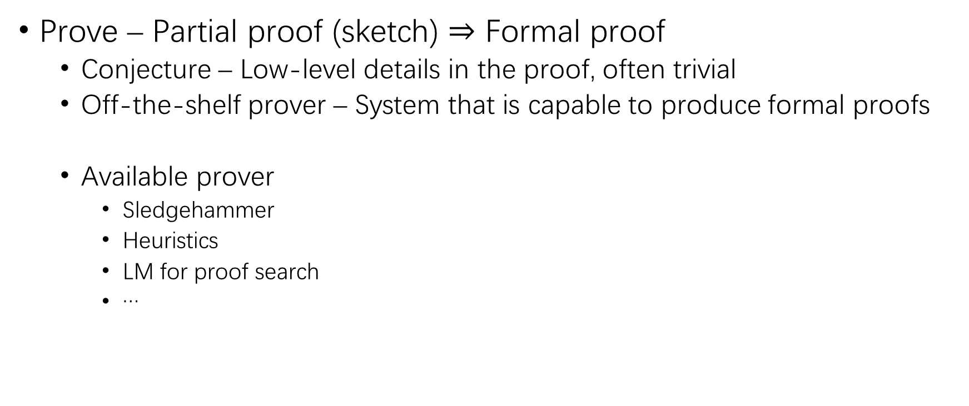
Prove Open Conjecture
Prove – Partial proof (sketch) $⇒$ Formal proof
Conjecture – Low-level details in the proof, often trivial
Off-the-shelf prover – System that is capable to produce formal proofs
Available prover
Sledgehammer
Heuristics
LM for proof search
…

Slide 15
Dataset & Baseline
MiniF2F – 488 problems from high-school math competitions
Problem – 260 from MATH dataset + 160 from actual competitions + 68 manually crafted
Formal language – Lean, HOL-Light, Isabelle
Split – 244 for valid, 244 for test
Baseline
Sledgehammer – 120s timeout, 5 provers (Z3, CVC4, SPASS, Vampire, E)
Sledgehammer + heuristics – 11 simple tactics, each 10s timeout; if all fail, then Sledgehammer
LM for proof search – Thor

Slide 16
Experimental Setup
Drafting
Codex code-davinci-002
Minerva 8B, 62B, 540B – PaLM further trained on a 118GB scientific paper dataset from arXiv and other web pages
Sketching
Demonstration pool – 10 algebra + 10 number theory from miniF2F valid
Prompt – 3 randomly sampled examples from the pool
Proving
Sledgehammer + heuristics

Slide 17
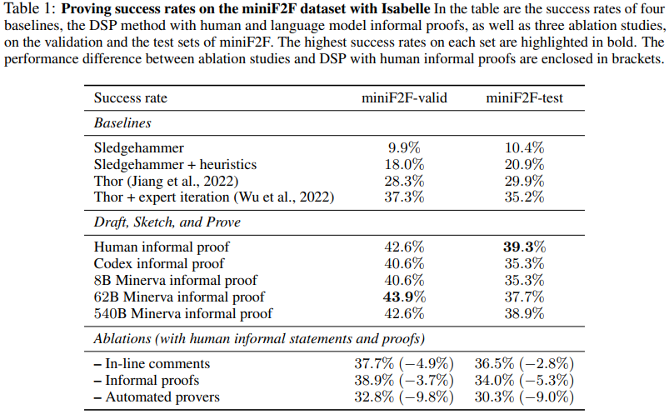
Result

Slide 18
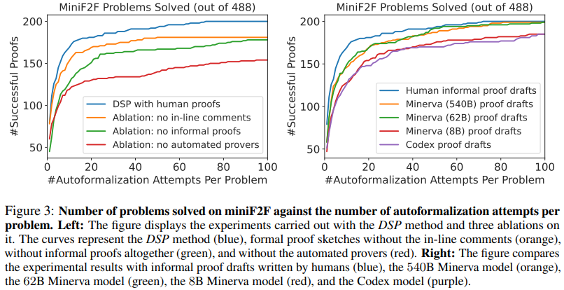
Result (2)

Slide 19
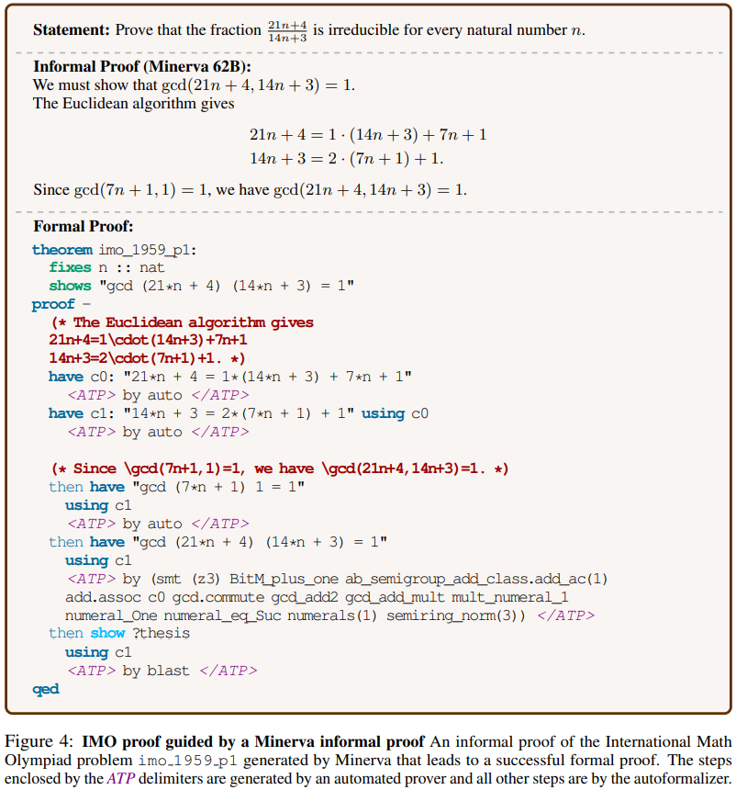
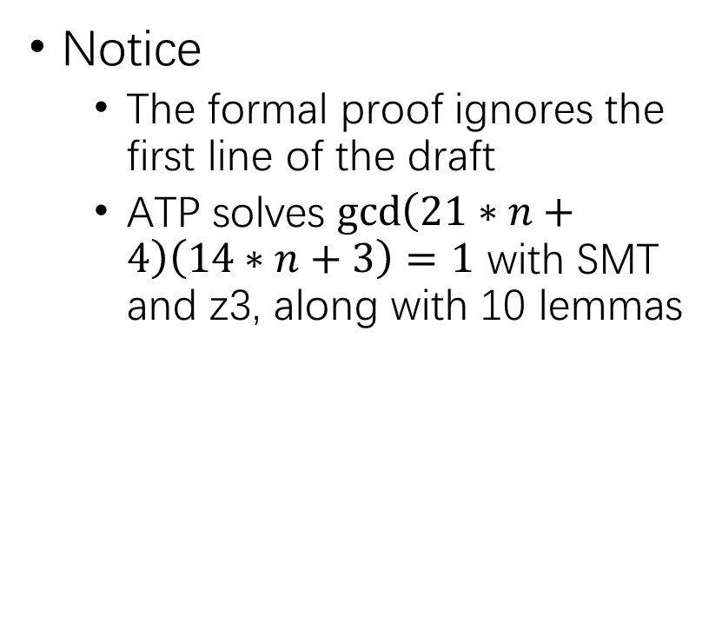
Result (3)
Notice
The formal proof ignores the first line of the draft
ATP solves $\gcd\left(21∗n+4\right)\left(14∗n+3\right)=1$ with SMT and z3, along with 10 lemmas

Slide 20
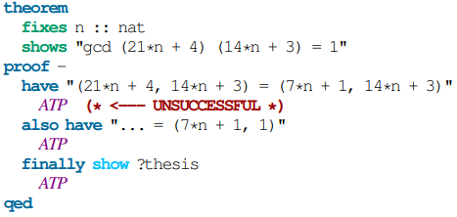
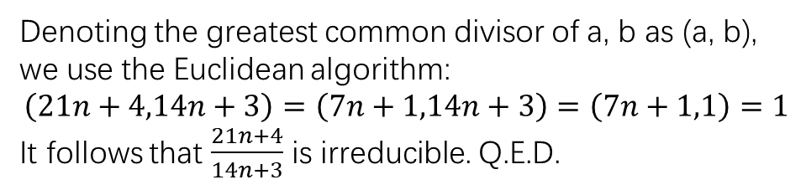
Result (4)
Unsuccessful human-written proof – Introduction of new notations
Denoting the greatest common divisor of a, b as (a, b), we use the Euclidean algorithm:
$$\left(21n+4,14n+3\right)=\left(7n+1,14n+3\right)=\left(7n+1,1\right)=1$$
It follows that $\frac{21n+4}{14n+3}$ is irreducible. Q.E.D.

Slide 21
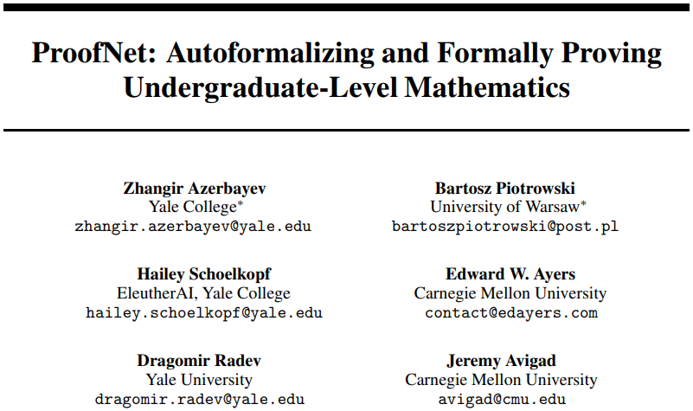

Slide 22
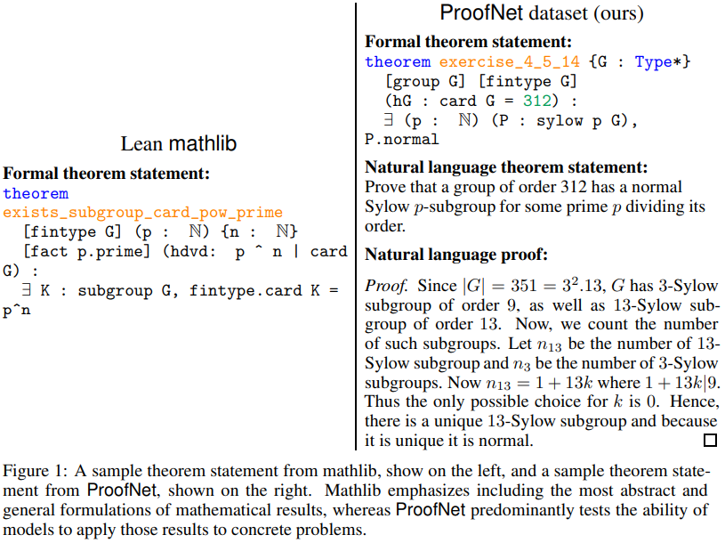
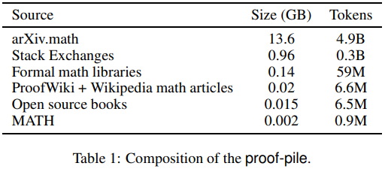
ProofNet (Lean)
ProofNet benchmark
371 examples from popular undergraduate pure math textbooks
Each example contains a Lean proof, an NL statement and an NL proof
ProofGPT
1.3B & 6.7B
Decoder-only casual LM fine-tuned on
proof-pile

Slide 23
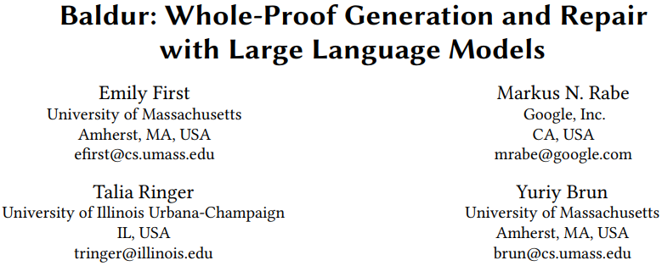

Slide 24
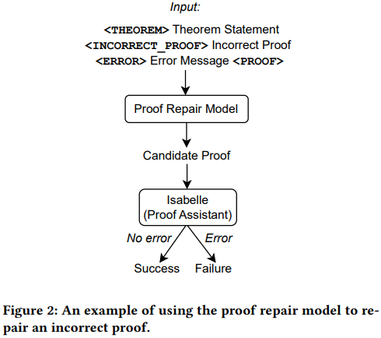
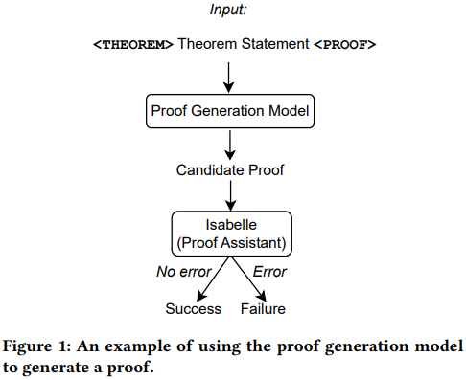
Baldur (Isabelle)
Whole proof generation
LLM pretrained upon NL and code, and finetuned on proofs
Proof repair
LLM finetuned to repair erroneous proofs

Slide 25
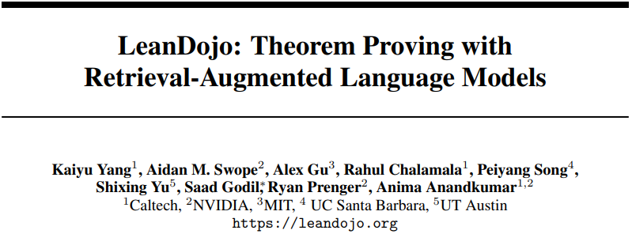

Slide 26
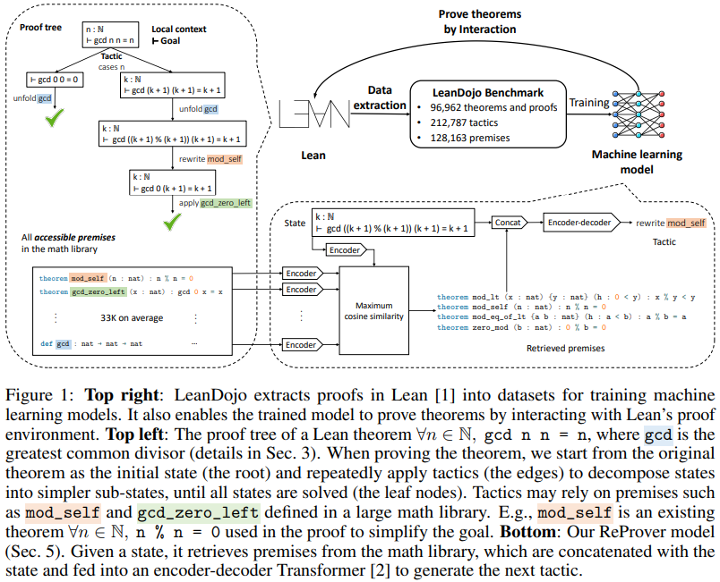
LeanDojo (Lean)
LeanDojo benchmark
92,962/2,000/2,000 theorems
Interactive toolkit provided
ReProver
Retrieve potentially useful premises (lemmas)
Generate tactics conditioned on the state and the retrieval results

Slide 27
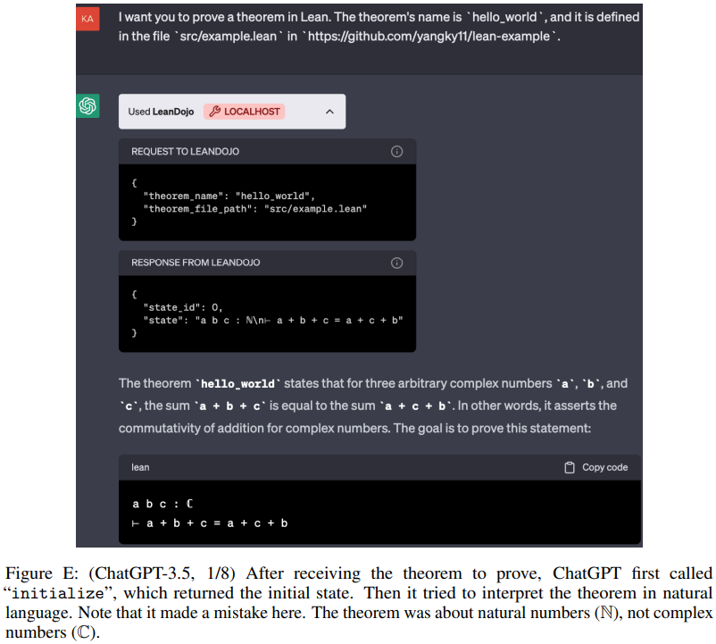
LeanDojo ChatGPT Plugin

Slide 28
THANK YOU!

